Slide 1
Introduction to Physical Computing: Week 3
Julia Makivic

Slide 2
Office Hours
Thursday 12pm - 4pm
Friday 12pm - 4pm

Slide 3
Detailed Dive into Devices, Sensors and Example Projects
Muscle sensors, pulse sensors, EEG waves
Wearable technologies
TFT LCD screens
LED matrices
Neopixels

Slide 4
Muscle Sensors
‘Sup Brows: https://learn.adafruit.com/heybrows
MyoWare muscle sensor:
https://learn.adafruit.com/getting-started-with-myoware-muscle-sensor
Tutorial: https://www.instructables.com/id/Muscle-EMG-Sensor-for-a-Microcontroller/

Slide 5
Pulse Sensors
Link to pulse sensor: https://pulsesensor.com/
Tutorial: https://create.arduino.cc/projecthub/Ingeimaks/diy-heart-rate-sensor-a96e89

Slide 6
Using EEG Waves With Arduino
Ridge of Sentiment by Yunny Jang:
http://doc.gold.ac.uk/compartsblog/index.php/work/ridge-of-sentiment/
Cheap EEG Machine:
https://www.aliexpress.com/item/32606318948.html?wgu=9271_196673_15747311628552_c08dd4c422&wgexpiry=1582507162&af=196673&dp=9271_196673_15747311628552_c08dd4c422&cn=9271&cv=15095
How to Use EEG Machine with Arduino:
https://www.instructables.com/id/Mini-Arduino-Portable-EEG-Brain-Wave-Monitor-/

Slide 7
Iris Scanning
The Sonic Pharmacy by Sarah Song
https://vimeo.com/359774955

Slide 8
LED Matrices
Some examples by Yours Truly!
https://www.youtube.com/watch?v=HAmOHAw7M5M
https://www.youtube.com/watch?v=coS4lLBMP3I
https://www.youtube.com/watch?v=7ENsdx2dDjQ
Snake on an LED Matrix:
https://www.youtube.com/watch?v=k6CHJ9VKTnY
LED Matrix Cube:
https://www.youtube.com/watch?v=T5Aq7cRc-mU

Slide 9
LED Matrices cont . . .
We Throw Switches Giant LED Matrix
https://twitter.com/WeThrowSwitches/status/1177592244049731585
BMO LED Keychain
https://learn.adafruit.com/3d-printed-led-animation-bmo/led-animations

Slide 10
TFT LCD Screens
Hooking up your Arduino to a TFT Screen:
https://www.arduino.cc/en/Guide/TFT
Examples:
Some examples by Yours Truly:
https://www.youtube.com/watch?v=oe9R97BWq7w
https://www.youtube.com/watch?v=I6FoPU3GPyg
Arduino Tamagotchi:https://www.instructables.com/id/Arduino-Tamagotchi-Clone-Digital-Pet/
Tutorial on setting up an Arduino LCD touchscreen:
https://www.instructables.com/id/Arduino-Touch-Screen-TFT-LCD-Tutorial-First-Review/
A Message From Our Sponsors: http://doc.gold.ac.uk/compartsblog/index.php/work/a-message-from-our-sponsor/
Steampunk Cameo Necklace: https://learn.adafruit.com/steampunk-cameo-necklace/overview

Slide 11
Neopixels
Full list of Neopixel products: https://www.adafruit.com/category/168
Sound to light Neopixel installation: https://www.programmingelectronics.com/arduino-sound-light-matrix-450-neopixels-student-project/
The Scarf is Lit: http://doc.gold.ac.uk/compartsblog/index.php/work/the-scarf-is-lit/
3D Printed Daft Punk Helmet: https://learn.adafruit.com/3d-printed-daft-punk-helmet

Slide 12
Wearables
Gemma: https://learn.adafruit.com/introducing-gemma
FLORA: https://www.adafruit.com/product/659
Playground Circuit Express: https://www.adafruit.com/product/3333
Speakers and microphone
Push buttons
10 LEDs
Infrared sensor and transmitter
Sound sensor, motion sensor, temperature sensor and altimeter
Capacitive touch inputs

Slide 13
Wearables cont . . .
Examples:
Flamethrower Arms: https://create.arduino.cc/projecthub/Advanced/punch-activated-arm-flamethrowers-real-firebending-95bb80?ref=tag&ref_id=wearables&offset=5
The Modern Conversation: http://doc.gold.ac.uk/compartsblog/index.php/work/the-modern-conversation/
Bao Bao Bag Concept: https://create.arduino.cc/projecthub/kimbab-studio/issey-miyake-bao-bao-bag-concept-by-kimbab-d84eaf?ref=tag&ref_id=wearables&offset=16
Hotaru by Kaho Abe:
https://kahoabe.net/portfolio/hotaru/
MIDI Drum Glove
https://learn.adafruit.com/midi-drum-glove

Slide 14
Where to search for these items
Pimoroni
https://shop.pimoroni.com/
Cool Components
https://coolcomponents.co.uk/
Farnell
https://uk.farnell.com/
RS Components
https://uk.rs-online.com/web/
Adafruit
https://learn.adafruit.com/
Based in the US, so try to use the distributors listed above to shop their components
User friendly
Plenty of libraries and how to guides to use their products in conjunction with Arduino and other devices

Slide 15
==LAB==

Slide 16
Last week’s homework
How can you create a new speculative design object using the sensors from lab? What would the object do? What physical, digital and “immaterial” materials would it use? What affordances would its material qualities provide and what sort of interaction would they enable?
Bonus: Research a new type of sensor on your own and create a speculative object that uses it.

Slide 17
Schematics
Abstract way of showing a circuit diagram
Doesn’t show where the components are connected, but shows how they are connected
Many projects will use circuit diagrams to show how components are connected instead of picture of a breadboard
Circuit diagrams are used to depict electronics in more detail

Slide 18
Schematics cont . . .
Great way to think about your circuit before putting it together
If you are having trouble, you can show someone what you were trying to do
If you ever want to mass produce or print your circuit, you will need to show a schematic to the manufacturer

Slide 19
Schematic and Circuit Design Tools
Fritzing: https://fritzing.org/home/
Beginner friendly
Arduino friendly
7 pounds
Eagle: https://www.autodesk.com/products/eagle/free-download
Free
Industry standard
Scriptable
Can be used to print circuit boards
Difficult interface

Slide 20
Schematic Examples:
Arduino Project Book: pg. 10
https://bastiaanvanhengel.files.wordpress.com/2016/06/arduino_projects_book.pdf
This page shows a list of schematic symbols for common components.

Slide 21
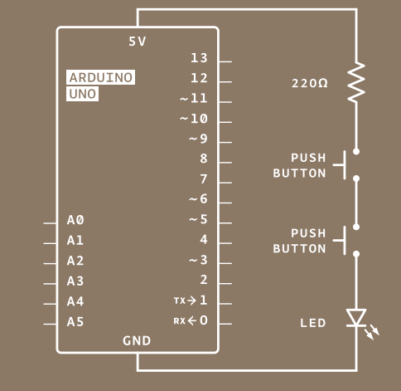
Describe this Schematic:

Slide 22
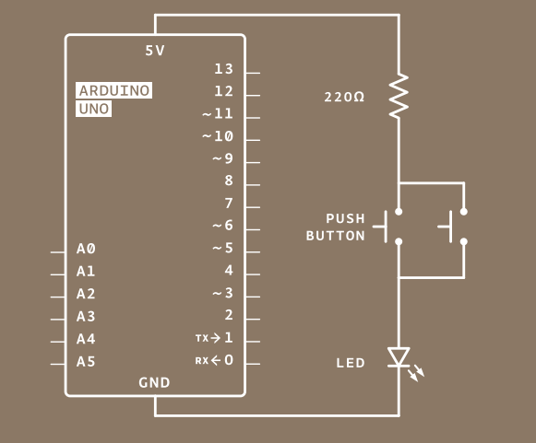

Slide 23
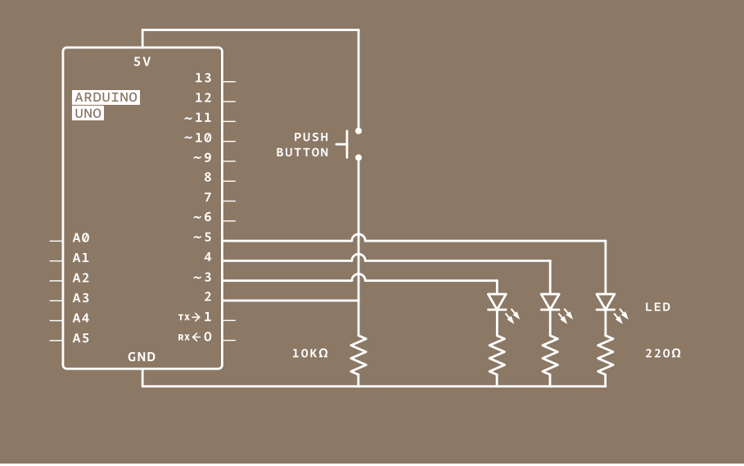

Slide 24
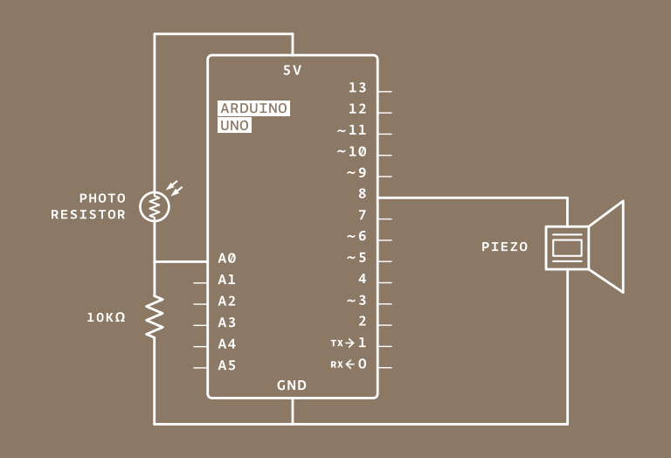
Light Theremin

Slide 25
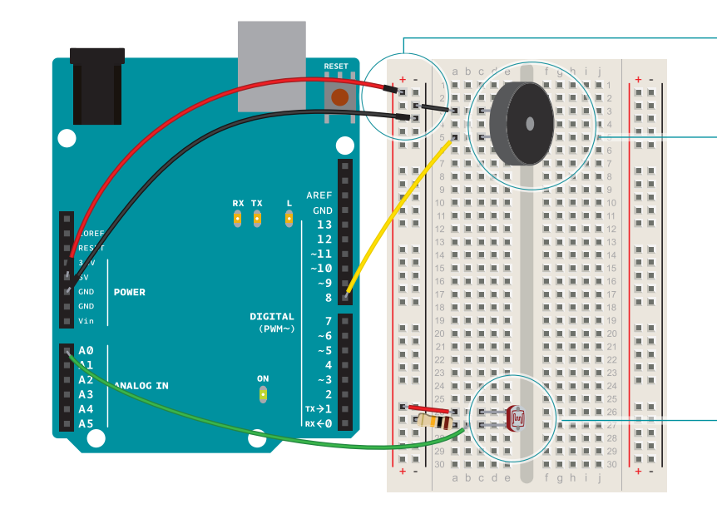
Light Theremin

Slide 26
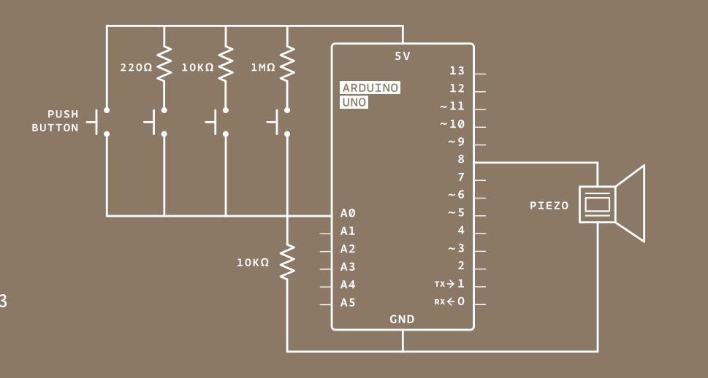
Keyboard Instrument

Slide 27
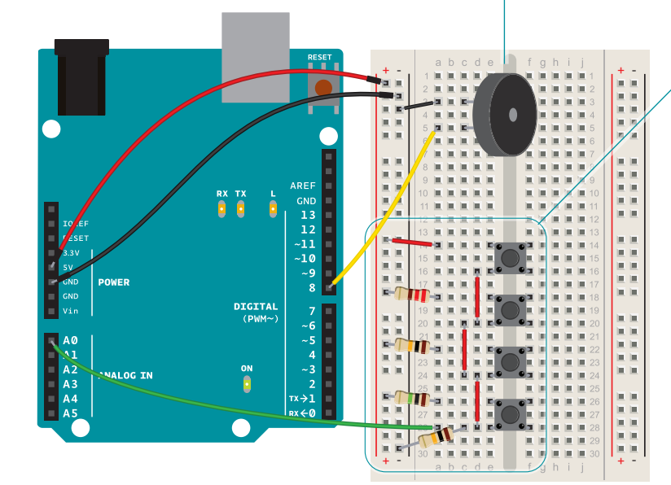
Keyboard Instrument

Slide 28
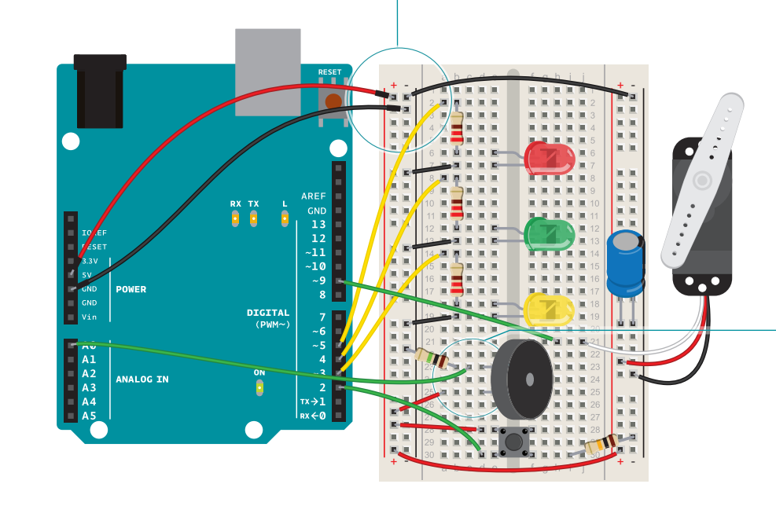
Knock Lock

Slide 29
Audio-Visual Improvisation
Make a schematic of your circuit
You know how to code a piezo and RGB LED. Use an input of your choice such as buttons, capacitive touch, temperature sensor, tilt switch, or piezo to create a piece with both light and sound.
Try to coordinate the light and sound. Maybe the sound can be influenced by the RGB values of the LED or vice versa

Slide 30
Homework
Study some of the examples I showed today. Take a look at the components and the code used (if provided). Try to understand how it all works together.
If you have any questions about the examples and would like a more detailed overview in class, let me know by November Saturday 30th and I will delve into further detail next class.

